Slide 1
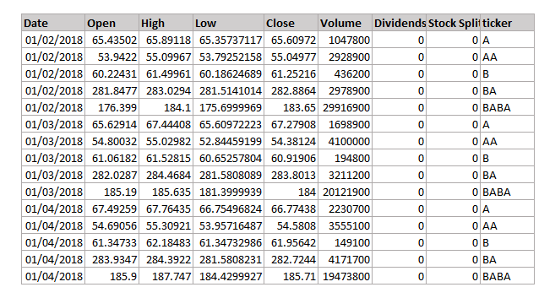
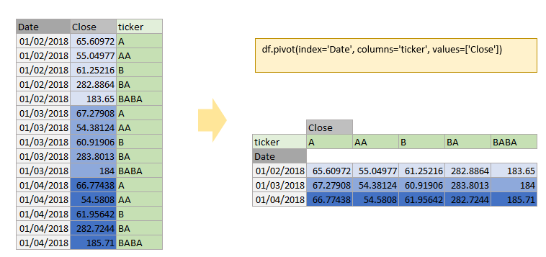
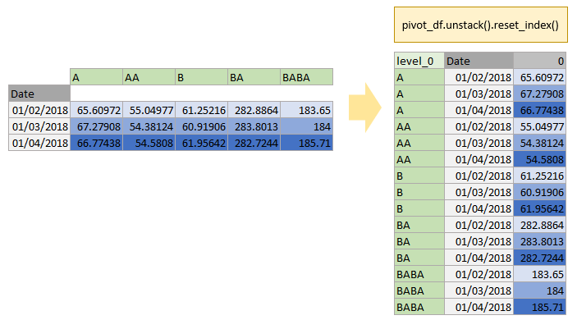
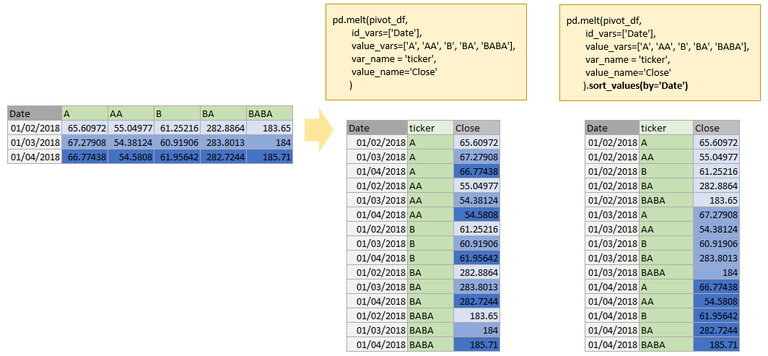
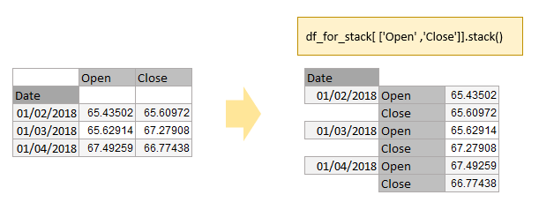
Pandas Cheat Sheet: Reshaping data
pivot
unstack
melt
stack

Slide 2

Pandas Cheat Sheet: Reshaping data
pivot
pivot_table

